Slide 1

THREE NUGGETS
Batch 12 , Group D

Slide 2
Today’s Presentation
Introduction
Literally Unemployed
Confusing Capitals
Corruption Scandals
Conclusion

Slide 3
Introduction
This is part of a Design Thinking (DT) project. The DT challenge is to raise the approval rating of the AP state government to 90%.
The steps We took to prepare these nuggets and this PowerPoint are we have taken a nugget and the information we heard or saw from people .

Slide 4




Literally Unemployed
Insight: People are not satisfied with the literacy rate and employment.
Evidence:
I saw people with good degree but unemployed
I heard people are not getting chance of entrepreneurship.
Movie title: Literally Unemployed
Poster: More number of graduates are unemployed.

Slide 5
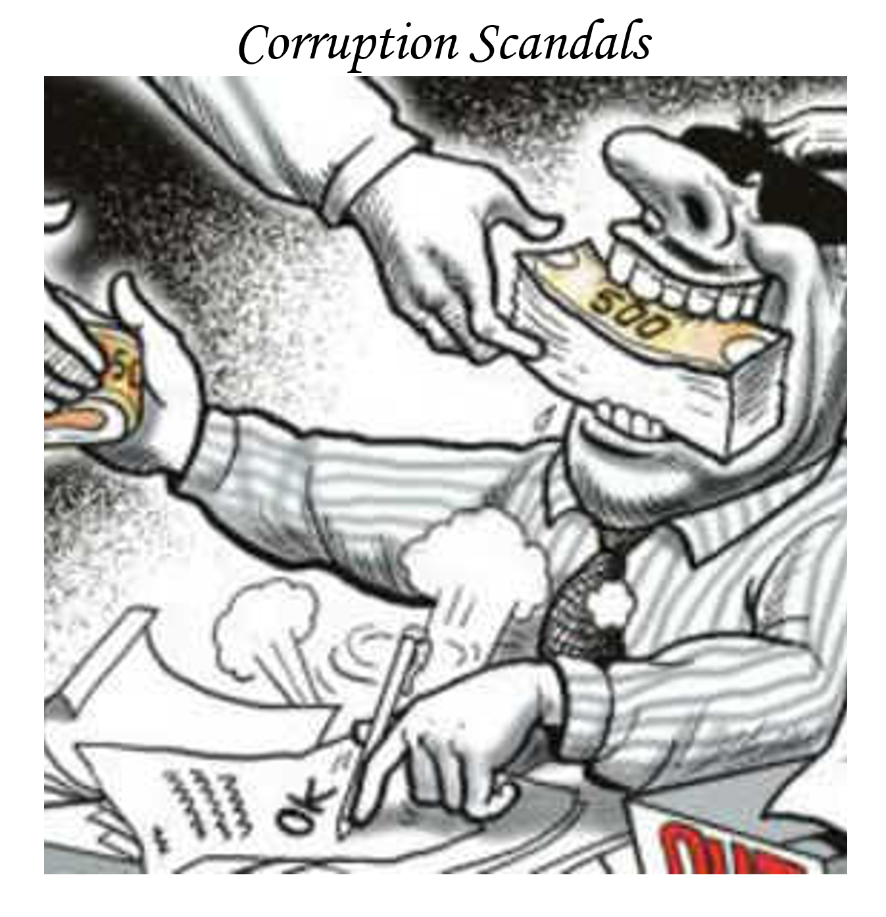
Corruption Scandals
Insight: Corruption of Government officials
Evidence:
I saw government officials taking bribe for land registrations etc…
Movie title: Corruption Scandals
Poster: Government official is taking money in order to approve the work or to do the work.

Slide 6
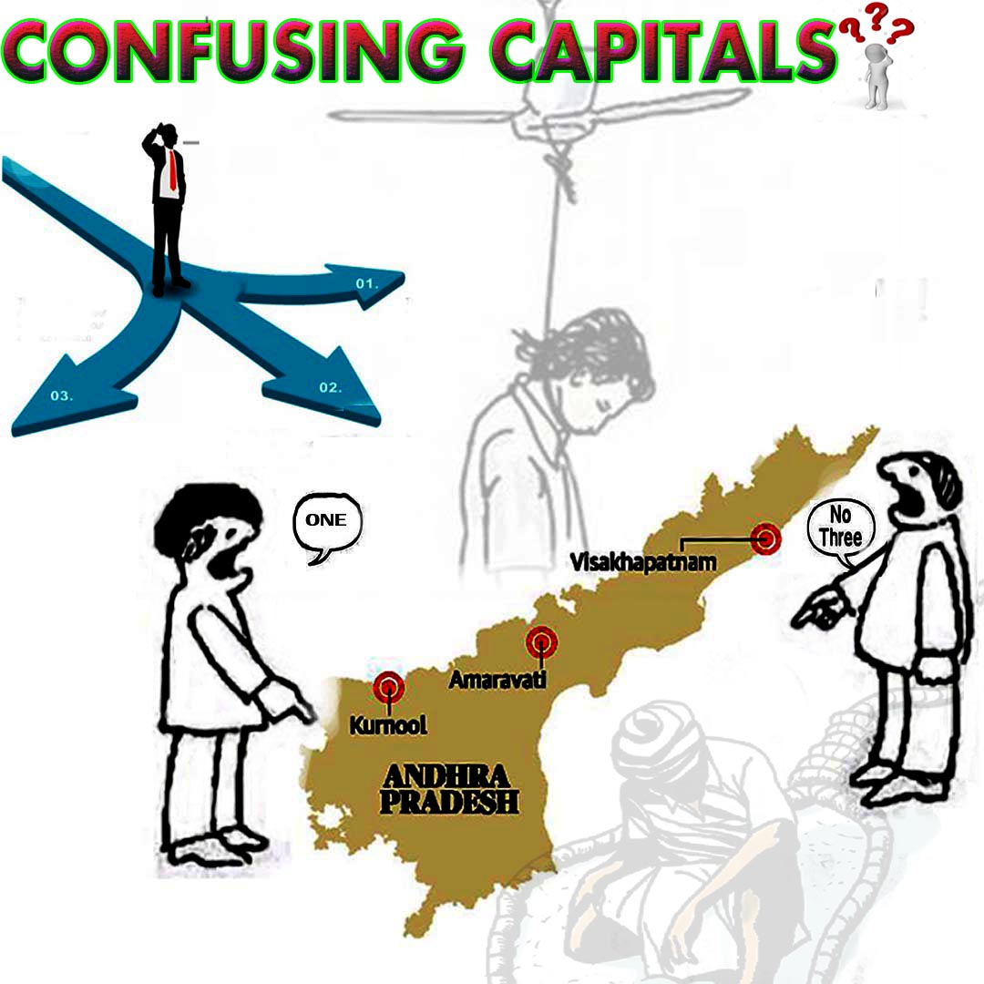
Confusing Capitals
INSIGHT: Citizens are not too happy for three capitals
EVIDENCE:
I saw that many people are fighting for one capital.
Movie-Style Title: Confusing Capitals
POSTER: Government confusing people by making tuff decisions by making three capitals even though they don't have enough money to fulfill the needs of ap people

Slide 7
Conclusion
Our team learned
About the importance of insights in Design Thinking like the sensible way to solve a problem.
About the right way to define and document an insight in a nugget form.

Slide 8
Thank You…! 👍
From Batch – 12 Project – D

